Slide 1
Correcting Common VLAN Configuration Errors
BSMSN Module 2 Lesson 5
Notes:
When VLANs span multiple switches, there are configuration challenges and issues to be overcome. VLAN configuration problems include security issues related to the 802.1Q native VLAN and Dynamic Trunking Protocol (DTP).
Upon completing this lesson, you will be able to identify common VLAN configuration errors and explain the solutions to those errors. This ability includes being able to meet these objectives:
Identify the security issues with 802.1Q native VLANs
Describe how to resolve the security issues with 802.1Q native VLANs
List key problems that result from trunk link configuration
Identify best practices for resolving trunk link problems
Identify common problems with VTP configuration
Describe best practice for VTP configuration

Slide 2
Objectives
Describe issues with 802.1Q Native VLANs and explain how to resolve those issues.
Describe trunk link problems and explain how to solve those.
Identify common problems with VTP configuration.
Describe best practices for using VTP in the Enterprise Composite Network Model.

Slide 3
Purpose of this Lesson
What’s new in this module?
  Description of issues with 802.1Q Native VLANs and how to resolve those issues.
  Description of trunk link problems and how to solve those.
  Common problems with VTP configuration.
  Best practices for using VTP.
This lesson does not cover VLANs. The VLAN modules of BCMSN are largely unchanged.

Slide 4
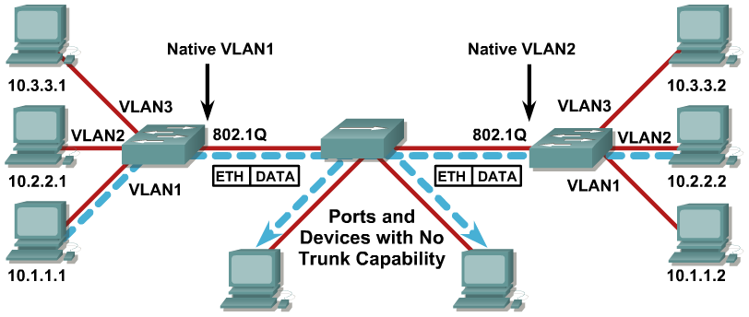
Different Native VLANs
  A native VLAN mismatch will merge traffic between VLANs.
Notes:
802.1Q trunking inserts a 4-byte 802.1Q tag field into frames sent over the trunk, which contain VLAN information. The 802.1Q tag is inserted into each frame transferred over the trunk except for frames transmitted on the native VLAN, which are sent untagged.
The native vlan is simply the default vlan that switch ports are placed into if they are not expressly placed into another VLAN. On Cisco switches, the native VLAN is VLAN 1. (This can be changed.) If dot1q is running, frames that are going to be sent across the trunk line don’t even have a header placed on them; the remote switch will assume that any frame that has no header is destined for the native VLAN.
In most cases, the native VLAN has to match on both sides of the trunk. If the native VLANs do not match, the switch logs Cisco Discovery Protocol (CDP) messages stating the mismatch.
While not catastrophic, this setup effectively causes the two different native VLANs to be merged into one larger L2 broadcast domain (VLAN). These two VLANs attempt to calculate one common Spanning Tree Protocol (STP) topology for such bridged native VLANs, with the risk of eventually exceeding the maximum supported STP diameter.

Slide 5
CDP and Unmatching Native VLANs
Instances where unmatching VLAN IDs are reported between two devices are displayed in the console in the following format:
  %NATIVE_VLAN_MISMATCH: native VLAN mismatch discovered on [local interface (local interface VLAN ID),] with [neighbor name neighbor interface (neighbor VLAN ID)]
In this example, a mismatch is reported on Ethernet 1/0 with native VLAN 5 and router1 Ethernet 2/3 with native VLAN 27:
  %NATIVE_VLAN_MISMATCH: native VLAN mismatch discovered on Ethernet1/0 (5), with router1 Ethernet2/3 (27)
Notes:
Cisco switches use Cisco Discovery Protocol (CDP) to warn of a native VLAN mismatch.
On select versions of Cisco IOS software, CDP may not be transmitted or will be automatically turned off if VLAN1 is disabled on the trunk.

Slide 6
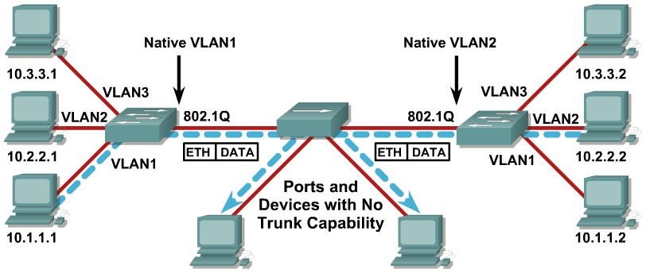
Untagged Frames
  Native VLAN frames are carried over the trunk link untagged.
Notes:
On an 802.1Q trunk port, all transmitted and received frames are tagged except for those on the VLAN configured as the native VLAN for the port. Frames on the native VLAN are always transmitted untagged and are normally received untagged.
Any untagged frames that an 802.1Q trunk receives will be forwarded to any ports in the native VLAN, which could be a security issue. This issue can be avoided by assigning an unused VLAN number to the native VLAN so that any untagged frames that an 802.1Q trunk receives will not be forwarded to any user ports.
In the example, the PCs connected to the hub will send untagged frames. Because the frames are untagged, they will become part of VLAN 1 on the left hand switch and part of VLAN 2 on the right hand switch. This exposes the PCs in VLAN 1 on the left side and VLAN 2 on the right side.

Slide 7
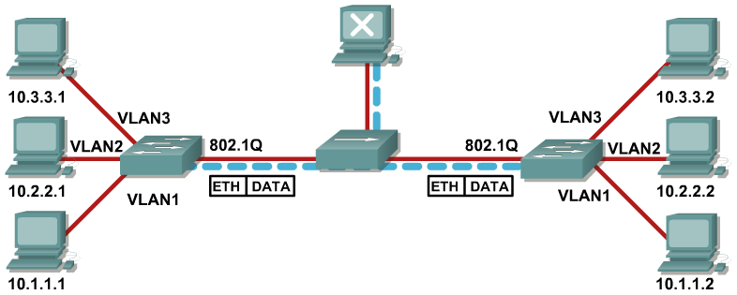
802.1Q Native VLAN Considerations
Native VLAN must match at ends of trunk otherwise frames will ‘leak’ from one VLAN to another.
By default the native VLAN will be VLAN1.
  Avoid using VLAN 1 for management purposes.
Eliminate native VLANs from 802.1Q trunks by making the native VLAN an ‘unused’ VLAN.
Notes:
Consider the following issues when you are configuring the native VLAN on an 802.1Q
trunk link:
The native VLAN interface configurations must match at both ends of the link or the trunk may not form.
By default, the native VLAN will be VLAN1. For the purpose of security, the native VLAN on a trunk should be set to a specific VLAN ID (VID) that is not used for normal operations elsewhere on the network.
If there is a native VLAN mismatch on either side of an 802.1Q link, Layer 2 loops may occur because VLAN 1 Spanning Tree Protocol (STP) Bridge Protocol Data Units (BPDUs) are sent to the IEEE STP MAC address (0180.c200.0000) untagged.
The native VLAN can be assigned any VLAN ID, and it is not dependent on the management VLAN.
When troubleshooting VLANs, note that a link can have one native VLAN association when in access mode, and another native VLAN association when in trunk mode.

Slide 8
Explaining Trunk Link Problems
Trunks can be configured statically or autonegotiated with DTP.
For trunking to be autonegotiated, the switches must be in the same VTP domain.
Some trunk configuration combinations will successfully configure a trunk, some will not.
The following elements determine whether or not an operational trunk link is formed as well as the type of trunk the link becomes:
  Trunking mode
  Trunk encapsulation type
  VLAN Trunk Protocol (VTP) domain
  Hardware capabilities of two connected ports

Slide 9
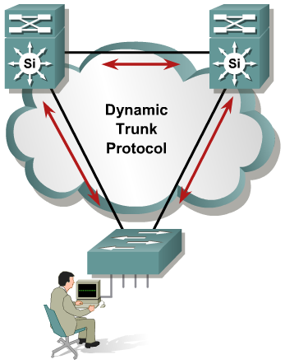
Dynamic Trunk Protocol (DTP)
What is DTP?
  Automates ISL/802.1Q trunk configuration
  Operates between switches
  Does not operate on routers
  Not supported on 2900XL or 3500XL
DTP synchronizes the trunking mode on link ends (i.e., native VLAN mismatch, VLAN range mismatch, encapsulation, etc.)
DTP states on ISL/dot1Q trunking port can be set to
  “auto”
  “on”
  “off”
  “desirable”
  “non-negotiate”
Notes:
If a port can become a trunk, it may also have the ability to trunk automatically, and in some cases even negotiate what type of trunking to use on the port. DTP provides this ability to negotiate the trunking method with the other device.

Slide 10
Trunk—Solution
Trunking Modes
Forms Trunk with Off
Forms Trunk with Auto
Forms
Trunk with Desirable
Forms Trunk with On
Forms Trunk with No Negotiate
Uses DTP
Off
No
No
No
No
No
No
Auto
Yes
No
No
Yes
Yes
No
Desirable
Yes
No
Yes
Yes
Yes
No
On
Yes
No
Yes
Yes
Yes
Yes
No Negotiate
No
No
No
No
Yes
Yes
Notes:
This chart illustrates the various combinations of settings on the connected switches that will either result in a trunk or not.

Slide 11

Resolving Trunk Link Problems
When using DTP, ensure that both ends of the link are in the same VTP domain.
Ensure that the trunk encapsulation type configured on both ends of the link is valid.
DTP should be turned off on links where trunking is not required.
Best practice is to configure trunk and nonegotiate where trunks are required.
Notes:
Trunk negotiation is managed by the Dynamic Trunking Protocol (DTP), which is a point-to-point protocol. When using DTP to configure trunks, ensure that both ends of the link are in the same VTP domain.
Because DTP is a Cisco proprietary protocol, some internetworking devices do not support DTP frames, which could cause misconfigurations. To avoid this potential problem, you should configure interfaces connected to devices that do not support DTP to not forward DTP frames to that device, that is, to turn off DTP.
Use the following commands to configure the ports into the appropriate mode:
If you do not intend to trunk across those links, use the switchport mode access interface configuration command to disable trunking.
To enable trunking to a device that does not support DTP, use the switchport mode trunk and switchport nonegotiate interface configuration commands to cause the interface to become a trunk but to not generate DTP frames.
Use the switchport trunk encapsulation isl or switchport trunk encapsulation dot1q interface to select the encapsulation type on the trunk port.

Slide 12
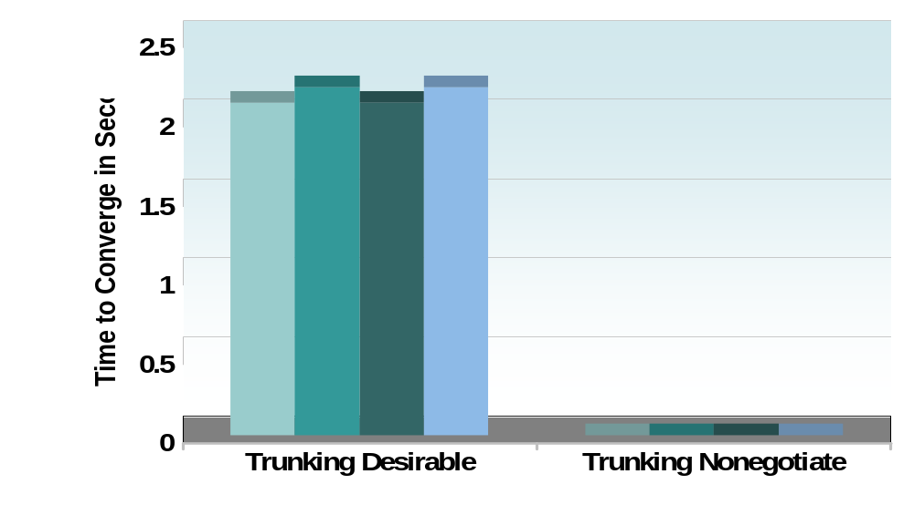
Optimizing Convergence: Trunk Tuning
Trunk Auto/Desirable Takes Some Time
DTP negotiation tuning improves link up convergence time
  IOS(config-if)# switchport mode trunk
  IOS(config-if)# switchport nonegotiate
Two Seconds of Delay/Loss Tuned Away
Notes:
By hardsetting trunks to be on and nonegotiate, 2 seconds of delay/loss can be avoided.
A ON/ON and NO NOEGOTIATE configuration is faster from a link up (restoration) perspective than a Desirable/Desirable alternative. However, in this configuration DTP is not actively monitoring the state of the trunk and a misconfigured trunk is not easily identified.

Slide 13
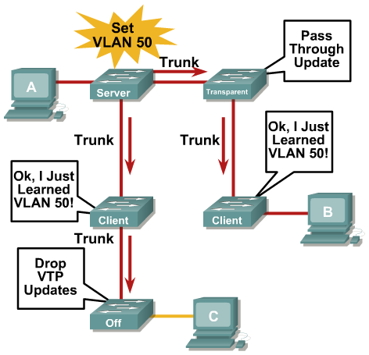
VTP Virtual Trunk Protocol
Centralized VLAN management
VTP server switch propagates VLAN database to VTP client switches
Runs only on trunks
Four modes:
  Server: updates clients
  and servers
  Client: receive updates—cannot make changes
  Transparent: let updates
  pass through
  Off: ignores VTP updates
Notes:
VTP rarely used – was very useful in flat layer2 environments where a common VLAN database was useful.

Slide 14
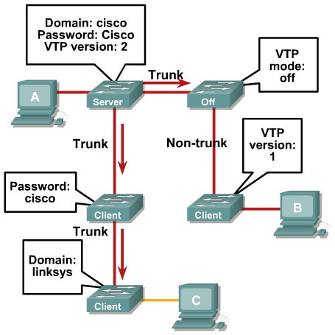
Common Problems with VTP Configuration
Check domain name
Check domain password
Check VTP version
Check trunk links
Check VTP modes
  At least 1 server?
Notes:
If updates are not received as expected:
VTP domain name must match on a given switch in order to receive updates from a VTP server. The domain name is case sensitive. Issue the show vtp domain command to verify the domain name. Issue the set vtp domain name command to set the VTP domain name.
Verify that the VTP password is the exactly same on all switches in the domain. The password is case sensitive. If a password is configured, it must be configured on all switches in the domain and the password must be the same. To clear a VTP password, issue the set vtp passwd 0 command.
VTP version must be compatible with other switches in the domain.
Ensure that there is at least one server in the domain.
Verify that the switches are connected through trunk links, as VTP updates are only exchanged over trunk links. Issue the show trunk command.
Verify the VTP mode on the switch. Switches in transparent mode do not update their VLAN configuration based on VTP updates from other switches. Switches in server mode or client mode do. Issue the show vtp domain command to verify the mode. Issue the set vtp mode {client | server | transparent | off} command to set the VTP mode.

Slide 15
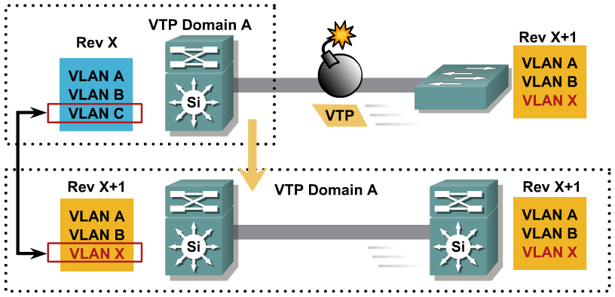
VLANs Disappear from Network
VTP Bomb occurs when a VTP Server with a Higher Revision of the VTP Database (Albeit Loaded with Potentially Incorrect Information) Is Inserted into the Production VTP Domain Causing the Loss of VLAN Information on All Switches in That VTP Domain
Notes:
If VLANs are missing:
Upon initial configuration, the VTP server may have had a partial VLAN database, and it overwrote the existing, more complete, database on an existing switch due to a higher revision number.
VLANs were deleted individually at the VTP server, and those deletions will be propagated in the domain. (To avoid this, ensure that any switch becoming a VTP server has a complete VLAN list.)
Not all Cisco switches support the same extended-range VLANs (those numbered higher than 1005). This information is not learned or propagated through VTP, so it may vary in a switched network.

Slide 16
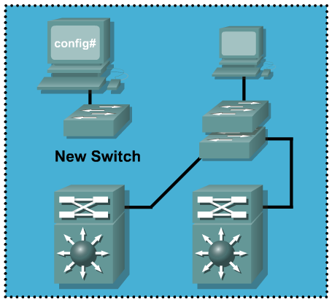
Example of New Switch Overwriting an Existing VTP Domain
New switch not connected:
Switch#show vtp status
VTP Version :2
Configuration Revision :2
Number of existing VLANs :7
VTP Operating Mode :Server
VTP Domain Name :building1
Existing switch:
Switch#show vtp status
VTP Version :2
Configuration Revision :1
Number of existing VLANs :6
VTP Operating Mode :Server
VTP Domain Name :building1
Notes:
The configuration revision number is used when determining if a switch should keep its existing VLAN database or overwrite it with the VTP update sent by another switch in the same domain with the same password. Therefore, when a switch is added to a network, it is important that it does not inject spurious information into the domain.
In this example a switch will be added to the existing topology. The new switch has a higher configuration register, 2. The existing switch has a configuration register of 1.

Slide 17
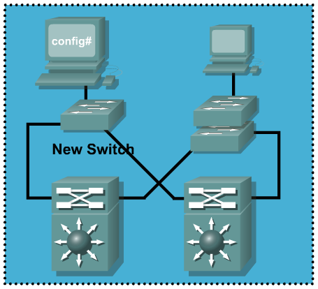
Example of New Switch Overwriting an Existing VTP Domain (cont.)
New switch after connection:
New switch connected
Switch#show vtp status
VTP Version :2
Configuration Revision :2
Number of existing VLANs :7
VTP Operating Mode :Server
VTP Domain Name :building1
Existing switch after adding new:
Switch#show vtp status
VTP Version :2
Configuration Revision :2
Number of existing VLANs :7
VTP Operating Mode :Server
VTP Domain Name :building1
Notes:
After the new switch is added, the revision number and VLANs have been updated on the VTP server…probably in error.
To avoid a VTP domain from being overwritten always add a new switch either in VTP transparent mode or as a VTP client with a revision number that is lower than the revision number in the existing VTP domain.
Before adding a VTP client to a VTP domain, always verify that its VTP configuration revision number is lower than the configuration revision number of the other switches in the VTP domain. Switches in a VTP domain always use the VLAN configuration of the switch with the highest VTP configuration revision number. If you add a switch that has a revision number higher than the revision number in the VTP domain, it can erase all VLAN information from the VTP server and VTP domain.

Slide 18
Resetting the VTP Revision Number
Use show vtp status command to check the VTP configuration revision number and the VTP domain name. If the revision number is 0, add the switch to the VTP domain. If the number is not 0, write down the domain name and proceed to Step 2.
Enter global configuration mode and use the vtp domain domain-name command to change the VTP domain name to something other than what was recorded in Step 1.
Issue the end command to exit configuration mode and save your changes
Use the show vtp status command to check the revision number. It should indicate 0.
Enter global configuration mode and use the vtp domain domain-name command to change the VTP domain name back to the name recorded in Step 1.
Issue the end command to exit configuration mode and save your changes
Use the show vtp status command to check the revision number. It should indicate 0.
Notes:
The configuration revision number is a 32-bit number that indicates the level of revision for a VTP packet. Each VTP device tracks the VTP configuration revision number that is assigned to it. Most of the VTP packets contain the VTP configuration revision number of the sender.
This information is used to determine whether the received information is more recent than the current version. Each time that you make a VLAN change in a VTP device, the configuration revision is incremented by one. In order to reset the configuration revision of a switch, change the VTP domain name, and then change the name back to the original name.
Replace the text on the slide with screen shots….

Slide 19
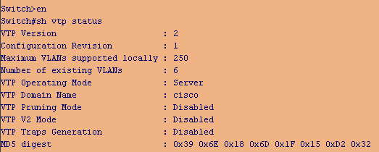
Check Revision Number, Record Domain
Notes:
Check the Configuration Revision number:
enable
show vtp status
Since the revision number is greater than 0, we will need to change the domain name in order to “zero out” the revision number before adding this switch to the topology.
Write down the VTP Domain name since you will want to reuse this after zeroing the revision number.

Slide 20
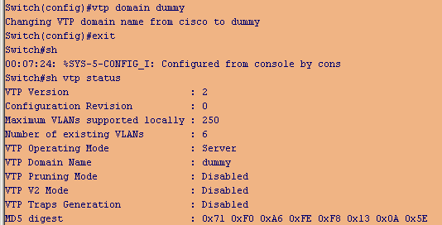
Change Domain to Something New, Save Changes
Notes:
From global configuration mode, change the domain name to something new…here we used “dummy”.
enable
configuration terminal
vtp domain dummy
exit
Use the show vtp status command to confirm that the revision number has been changed to “0”.

Slide 21
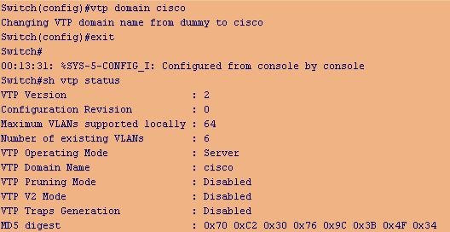
Change Domain Back to Original and Confirm
Notes:
Change the VTP Domain back to the original value.
enable
configure terminal
vtp domain cisco
exit
Confirm that the Configuration Revision number is now “0”
enable
show vtp status

Slide 22
Implementing VTP in the
Enterprise Composite Network Model
Plan VTP domain boundaries.
Have only one or two VTP servers.
Configure a VTP password.
Manually configure the VTP domain name on all devices.
When setting up a new domain
  Configure VTP client switches first so that they participate passively
When cleaning up an existing VTP domain
  Configure passwords on servers first because clients may need to maintain current VLAN information until the server is verified as complete.
Notes:
Following is a list of general best practices with regard to configuring VTP in the enterprise composite network model:
Plan boundaries for the VTP domain. By default, all switches are configured to be VTP servers. This configuration is suitable for small-scale networks in which the size of the VLAN information is small and the information is easily stored in all switches (in NVRAM). In a large network, the network administrator must make a judgment call at some point, when the NVRAM storage that is necessary is wasteful because it is duplicated on every switch. At this point, the network administrator must choose a few well-equipped switches and keep them as VTP servers. Everything else that participates in VTP can be turned into a client. The number of VTP servers should be chosen to provide the degree of redundancy that is desired in the network. In the enterprise composite model, the VTP domain should be restricted to redundant distribution switches and the access switches that they serve.
Configure a password so that no switch can join the VTP domain with a domain name only (which can be derived dynamically).
Manually configure VTP domain name on all switches that are installed in the network so that the mode can be specified and the default mode of server on all switches can be overwritten.
When you are setting up a new domain, configure VTP client switches first so that they participate passively; then configure servers to update client devices.
In an existing domain, if you are performing VTP cleanup, configure passwords on servers first. Clients may need to maintain current VLAN information until the server contains a complete VLAN database. After the VLAN database on the server is verified as complete, client passwords can be configured to be the same as the servers. Clients will then accept updates from the server.
Notes:
If a switch is configured as a VTP server without a VTP domain name, you cannot configure a VLAN on the switch.
If a new Catalyst is attached in the border of two VTP domains, the new Catalyst keeps the domain name of the first switch that sends it a summary advertisement. The only way to attach this switch to another VTP domain is to manually set a different VTP domain name.
Dynamic Trunking Protocol (DTP) sends the VTP domain name in a DTP packet. Therefore, if you have two ends of a link that belong to different VTP domains, the trunk does not come up if you use DTP. In this special case, you must configure the trunk mode as on or nonegotiate, on both sides, in order to allow the trunk to come up without DTP negotiation agreement.
If the domain has a single VTP server and it crashes, the best and easiest way to restore the operation is to change any of the VTP clients in that domain to a VTP server. The configuration revision will still be the same in the rest of the clients, even if the server crashes. Therefore, VTP will work properly in the domain.

Slide 23
Activity
You are tasked with adding a new switch to the existing network. The network is running VTP.
Describe the steps you would take to ensure that the new switch did not overwrite the existing configuration.
Notes:
The configuration revision of the new switch should be reset as follows:
Use show vtp status command to check the VTP configuration revision number and the VTP domain name. If the revision number is 0, add the switch to the VTP domain in transparent or client mode. If the number is not 0, write down the domain name and proceed to Step 2.
Enter global configuration mode and use the vtp domain domain-name command to change the VTP domain name to something other than what was recorded in Step 1.
Issue the end command to exit configuration mode and save your changes
Use the show vtp status command to check the revision number. It should indicate 0.
Enter global configuration mode and use the vtp domain domain-name command to change the VTP domain name back to the name recorded in Step 1.
Issue the end command to exit configuration mode and save your changes
Use the show vtp status command to check the revision number. It should indicate 0.
Add the switch to the network in transparent or client mode.
Show the VTP status to check that the switch has learned the VLAN configuration settings via VTP.

Slide 24
Self Check
What is the danger of mismatched native VLANs?
What is the default native VLAN?
In a DTP configuration, what elements determine whether or not an operational trunk link is formed as well as the type of trunk the link becomes?
Name 4 VTP modes and describe their VTP roles.
What is a VTP Bomb?
Notes:
While not catastrophic, this setup effectively causes the two different native VLANs to be merged into one larger L2 broadcast domain (VLAN).
VLAN 1
4 factors determine whether or not an operational trunk link is formed using DTP as well as the type of trunk the link becomes: Trunking mode, Trunk encapsulation type, VLAN Trunk Protocol (VTP) domain, and Hardware capabilities of two connected ports.
Server: updates clients and servers, Client: receive updates—cannot make changes, Transparent: let updates
pass through, and Off: ignores VTP updates.
VTP Bomb occurs when a VTP server with a higher revision of the VTP Database is inserted into the production VTP domain causing the loss of VLAN information on all switches in that VTP domain.

Slide 25
Summary
802.1Q native VLAN can cause security issues.
Configure the native VLAN to be an ‘unused’ VLAN.
Some trunk link configuration combinations can result in problems on the link.
Best practice is to configure trunks statically rather than
with DTP.
Misconfiguration of VTP can give unexpected results.
Make only one or two VTP servers; keep the remainder as clients.

Slide 26
Resources
DTP Messages:
  http://www.cisco.com/univercd/cc/td/doc/product/lan/cat2950/12111yj/2950smg/msg_desc.htm#xtocid3
Cisco Command Reference:
  http://www.cisco.com/en/US/products/ ps6441/prod_command_ reference_list.html
TAC Case Collection (requires CCO login)
  http://www.ciscotaccc.com/lanswitching/home

Slide 27

Q and A

